Slide 1


Slide 2

#LifeKoKaroLift
SGC Coaching:
Articulate your Journey | Activate Students’ Vigour| Accelerate Mutual Growth
Session 4
Advance SQL

Slide 3
Agenda
Quick Recap –(10 mins)
Last 2 weeks
Focused Teaching –(50 mins)
Advance SQL
Doubt resolution –(30 mins)
Explain using demonstration and exercises

Slide 4
Recap: What the learner have learnt in the week
Quick Glance at Key Learnings
DDL
DQL
Select
Create
Insert
Drop
DML
Alter
Truncate
Update
Delete

Slide 5
Focussed teaching: Points of Investigation
Joins and Union
Triggers and Routines
Best Practise
Sub-Query(Nested Query)

Slide 6
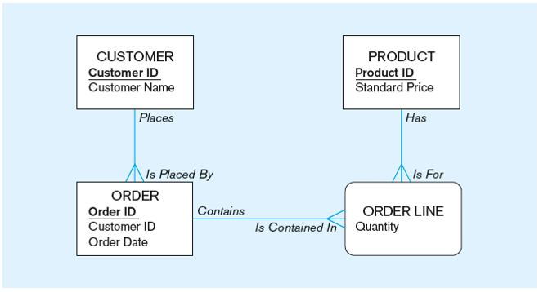
Focussed teaching: ERD

Slide 7
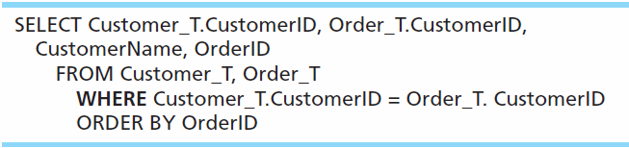
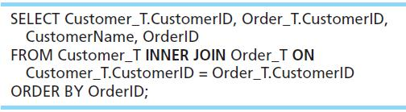
Focussed teaching: Joins and Union
Q) For each customer who placed an order, what is the customer’s name and order number?
Notes:
INNER JOIN clause is an alternative to WHERE clause, and is used to match primary and foreign keys.
An INNER join will only return rows from each table that have matching rows in the other.
This query produces same results as previous equi-join example.

Slide 8
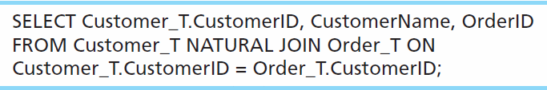
Focussed teaching: Joins and Union
For each customer who placed an order, what is the customer’s name and order number?

Slide 9
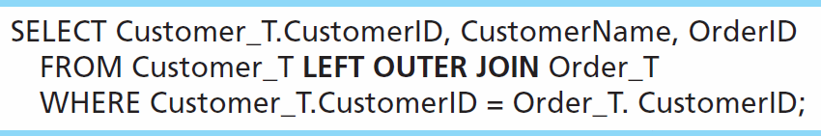
Focussed teaching: Joins and Union
List the customer name, ID number, and order number for all customers. Include customer information even for customers that do have an order.

Slide 10
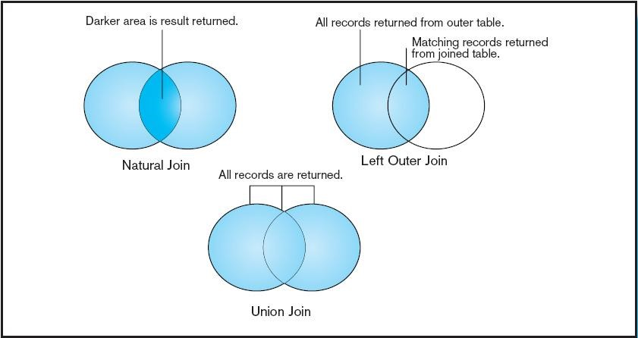
Focussed teaching: Joins and Union

Slide 11
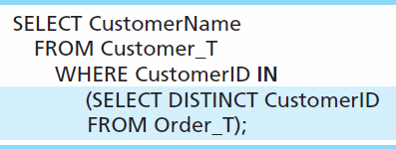
Focussed teaching: Nested Query
Q) Show all customers who have placed an order
Subquery is embedded in parentheses. In this case it returns a list that will be used in the WHERE clause of the outer query

Slide 12
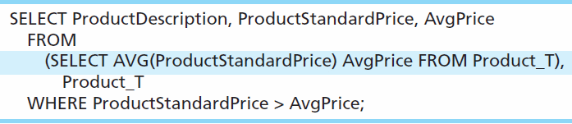
Focussed teaching: Nested Query
Show all products whose standard price is higher than the average price
One column of the subquery is an aggregate function that has an alias name. That alias can then be referred to in the outer query
The WHERE clause normally cannot include aggregate functions, but because the aggregate is performed in the subquery its result can be used in the outer query’s WHERE clause
Subquery forms the derived table used in the FROM clause of the outer query

Slide 13
Focussed teaching: Trigger and Routine
Triggers–routines that execute in response to a database event (INSERT, UPDATE, or DELETE)
Routine: Program modules that execute on demand

Slide 14
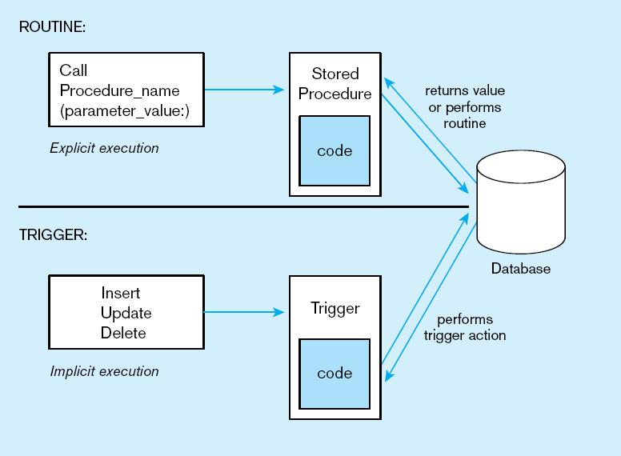
Focussed teaching: Trigger and Routine

Slide 15
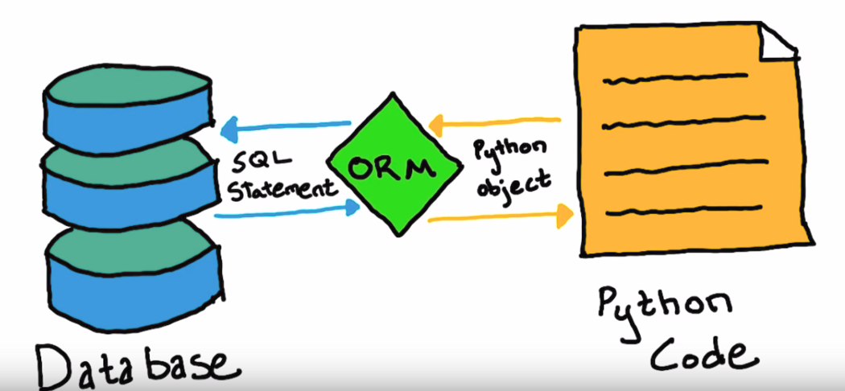
Focussed teaching: ORM
As the query get complicated its difficult for developer to maintain it in code.
Can we make something which make it easy for developer?

Slide 16
Focussed teaching: ORM
# filter command
books_by_JK = Books.objects.filter(author=”JK Rowling”)
for book in books_by_JK: print(book)
Or
Create command
Books.object.create(author=”JK Rowling”,name=”Harry Potter returns with his magical wand”)

Slide 17
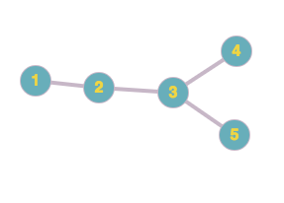
Focussed teaching:
You have to identify the 2nd degree and 3rd degree friend of person 1?

Slide 18
Focussed teaching:
You have to identify the 2nd degree and 3rd degree friend of person 1?
Customer_id | Name
1 | ABC
2 | LMN
3 | XYZ
4 | AAA
5 | BBB
Friendship_id | 1stFriend | 2ndFriend
1 | 1 | 2
2 | 2 | 3
3 | 3 | 4
4 | 3 | 5
UserTable
Friendshiptable
Select Name from Usertable where customer_id IN
(Select 2ndFriend from FreindshipTable where 1stFriend in
(Select 2ndFriend from FreindshipTable where 1stFriend = 1))

Slide 19
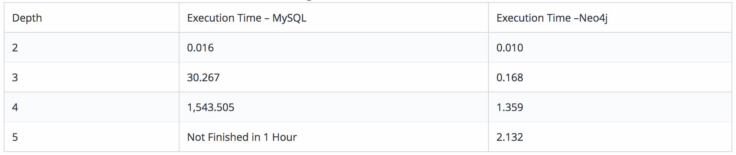
Focussed teaching:
You have to identify the 2nd degree and 3rd degree friend of person 1?
Execution Time is in seconds, for 1,000 users.

Slide 20
Focussed teaching: Query Efficacy
Be familiar with the data model (entities and relationships)
Understand the desired results
Know the attributes desired in result
Identify the entities that contain desired attributes
Review ERD
Construct a WHERE equality for each link
Fine tune with GROUP BY and HAVING clauses if needed
Consider the effect on unusual data

Slide 21
Focussed teaching: Query Efficacy
Instead of SELECT *, identify the specific attributes in the SELECT clause; this helps reduce network traffic of result set
Limit the number of subqueries; try to make everything done in a single query if possible
If data is to be used many times, make a separate query and store it as a view

Slide 22

Doubt resolution
Questions??

